Slide 1
Supervised3 Logistic regression
資料科學 Data Science
張家銘 Jia-Ming Chang
政治大學資訊科學系
The slide isonly for educational purposes. If any infringement, please contact me, we will correct immediately.

Slide 2
Copyright declaration 版權說明
Some of the figures in this presentation are taken from "An Introduction to Statistical Learning, with applications in R" (Springer, 2013) with permission from the authors: G. James, D. Witten, T. Hastie and R. Tibshirani.
The web site of the book
The credit of individual is indicated in the bottom part of the slide.
ie.,

Slide 3
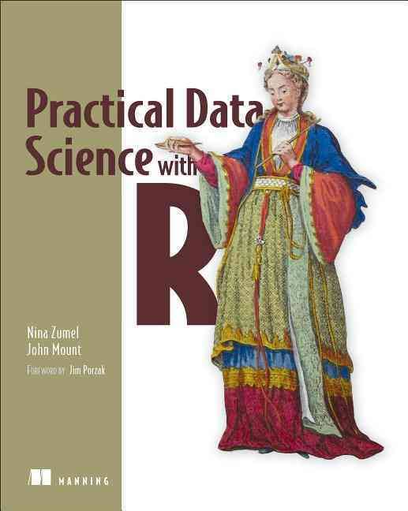
Copyright declaration 版權說明
Some of the figures in this presentation are taken from "Practical Data Science with R (Manning, 2019)”
The web site of the book
The credit of individual is indicated in the bottom part of the slide.
ie.,

Slide 4
Copyright declaration 版權說明
Some of the figures in this presentation are taken from "R for Data Science” under the Creative Commons Attribution-NonCommercial-NoDerivs 3.0 License.
The web site of the book
The credit of individual is indicated in the bottom part.
ie.,

Slide 5
Chp. 7: Linear and logistic regression
Chp 4. Classification

Slide 6
Linear and logistic regression
Extracting relations and advice from functional models
Linear regression
predict quantities
Interpreting the diagnostics from lm call
Logistic regression
predict probabilities or categories
Interpreting the diagnostics from glm call
Practical Data Science with R by Nina Zumel, John Mount

Slide 7
Linear and logistic regression
This class of methods is especially useful when you don’t just want to predict an outcome, but you also want to know the relationship between the input variables and the outcome.
This knowledge can prove useful because this relationship can often be used as advice on how to get the outcome that you want.
Practical Data Science with R by Nina Zumel, John Mount

Slide 8
Logistic regression

Slide 9
Logistic regression
directly predict values that are restricted to the (0,1) interval, such as probabilities
the coefficients of a logistic regression model can be treated as advice
a good first choice for binary classification problems
Practical Data Science with R by Nina Zumel, John Mount

Slide 10
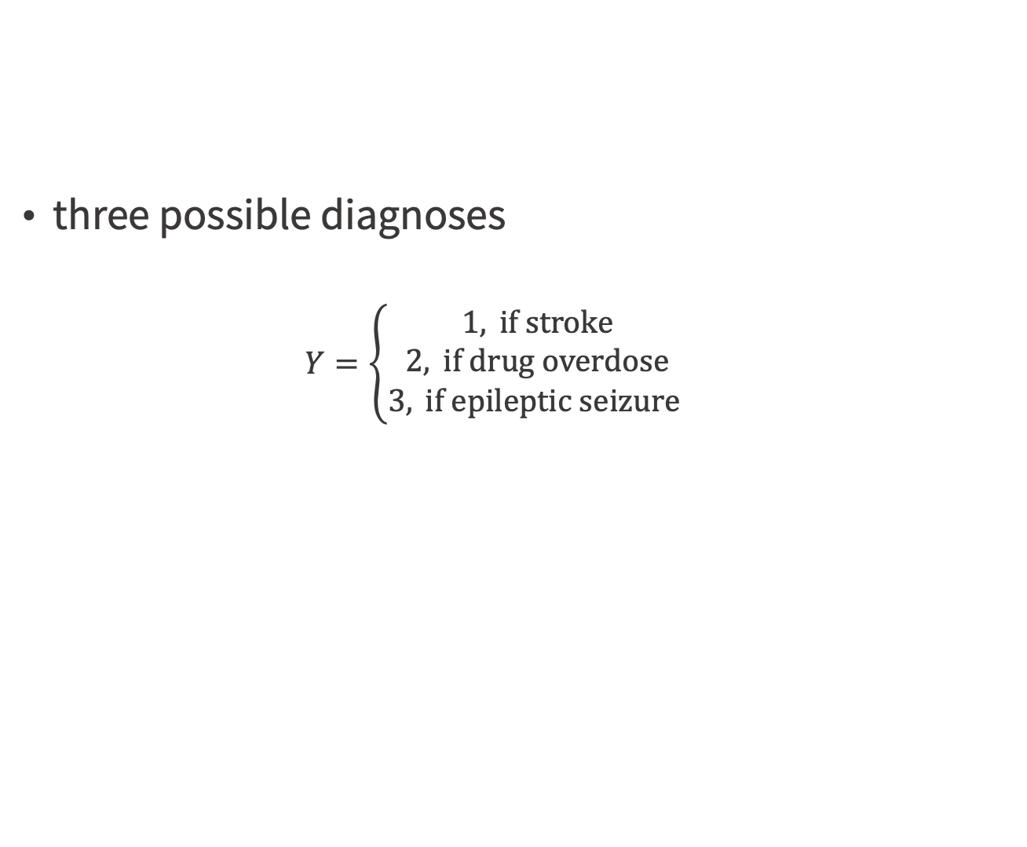
Why Not Linear Regression?
three possible diagnoses
$$Y=\left\{\begin{aligned}1, \text{if} \text{stroke} \\ 2, \text{if} \text{drug} \text{overdose} \\ 3, \text{if} \text{epileptic} \text{seizure} \end{aligned}\right.$$
An Introduction to Statistical Learning with Applications in R by Gareth James, Daniela Witten, Trevor Hastie, Robert Tibshirani​

Slide 11
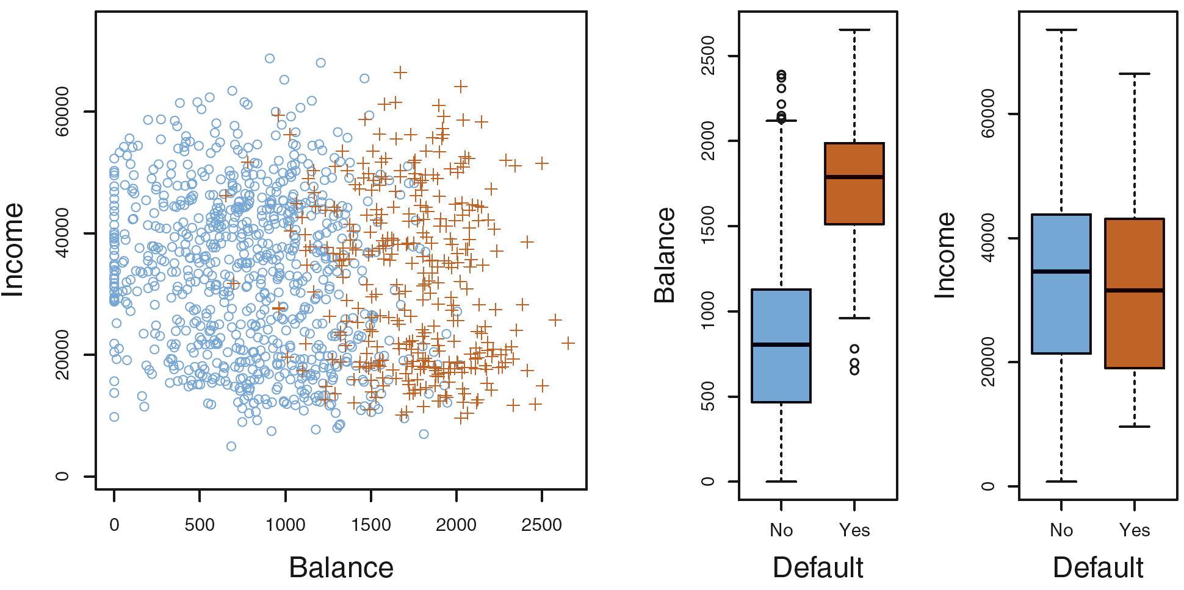
Pr(default=Yes|balance)
Figure4.1, p129, An Introduction to Statistical Learning, with applications in R" (Springer, 2013) with permission from the authors: G. James, D. Witten, T. Hastie and R. Tibshirani

Slide 12
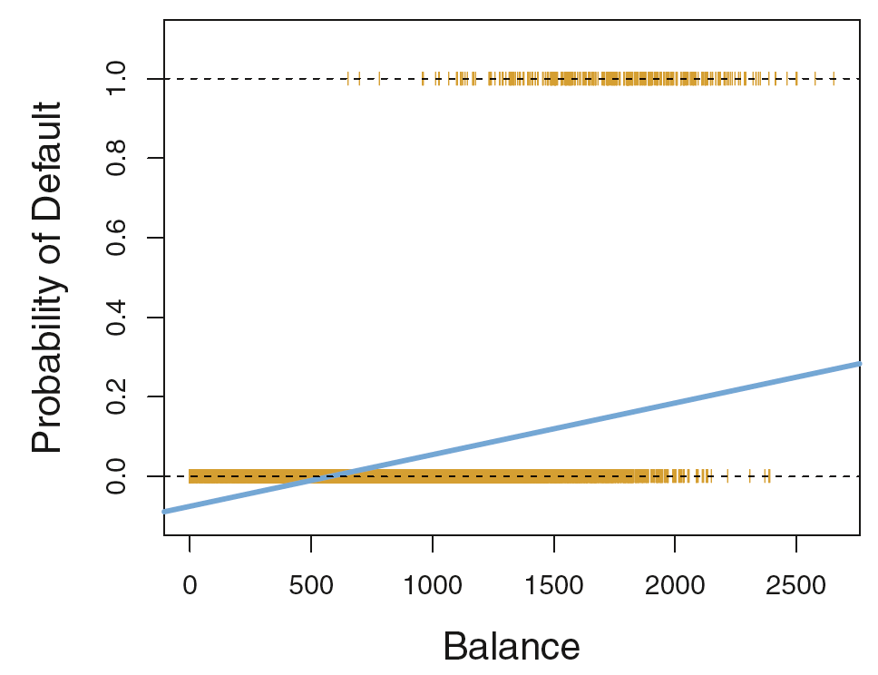
p(x) be a linear function of x?
p(X) = Pr(Y = 1|X) = β₀ + β₁X
p(default=Yes) = β₀ + β₁balance
Figure4.2, p131, An Introduction to Statistical Learning, with applications in R" (Springer, 2013) with permission from the authors: G. James, D. Witten, T. Hastie and R. Tibshirani

Slide 13
Diminishing returns
in principle we can always
predict p(X) < 0 for some values of X
p(X) > 1 for others
Credit by http://www.stat.cmu.edu/~cshalizi/uADA/12/lectures/ch12.pdf

Slide 14
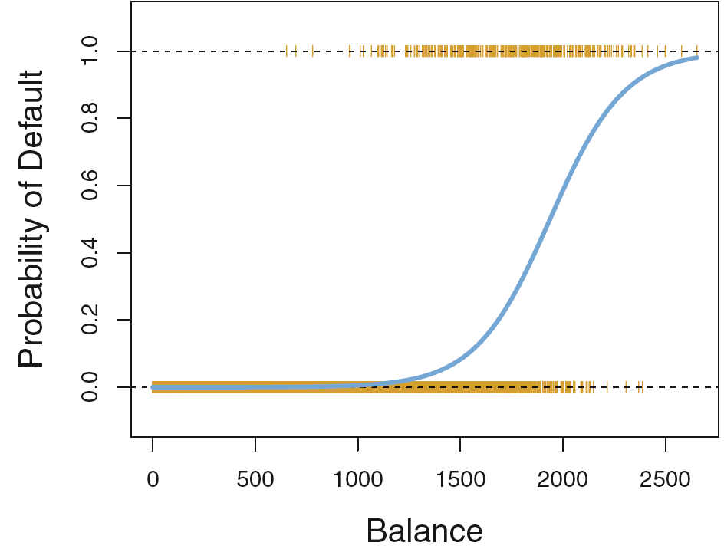
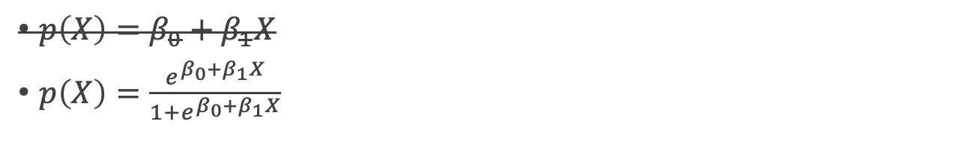
Logistic function
${p\left(X\right)=β}_{0}+β_{1}X$
$p\left(X\right)=\frac{e^{β_{0}+β_{1}X}}{1+e^{β_{0}+β_{1}X}}$
S-shaped curve
Figure4.2, An Introduction to Statistical Learning with Applications in R by Gareth James, Daniela Witten, Trevor Hastie, Robert Tibshirani

Slide 15
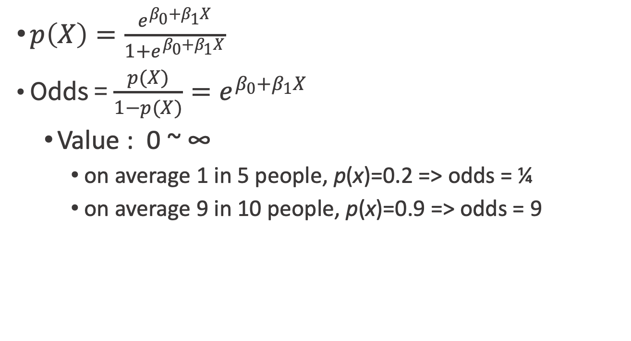
Odds
$p\left(X\right)=\frac{e^{β_{0}+β_{1}X}}{1+e^{β_{0}+β_{1}X}}$
Odds = $\frac{p(X)}{1−p(X)}=e^{β_{0}+β_{1}X}$
Value : 0 ~ ∞
on average 1 in 5 people, p(x)=0.2 => odds = ¼
on average 9 in 10 people, p(x)=0.9 => odds = 9
An Introduction to Statistical Learning with Applications in R by Gareth James, Daniela Witten, Trevor Hastie, Robert Tibshirani

Slide 16
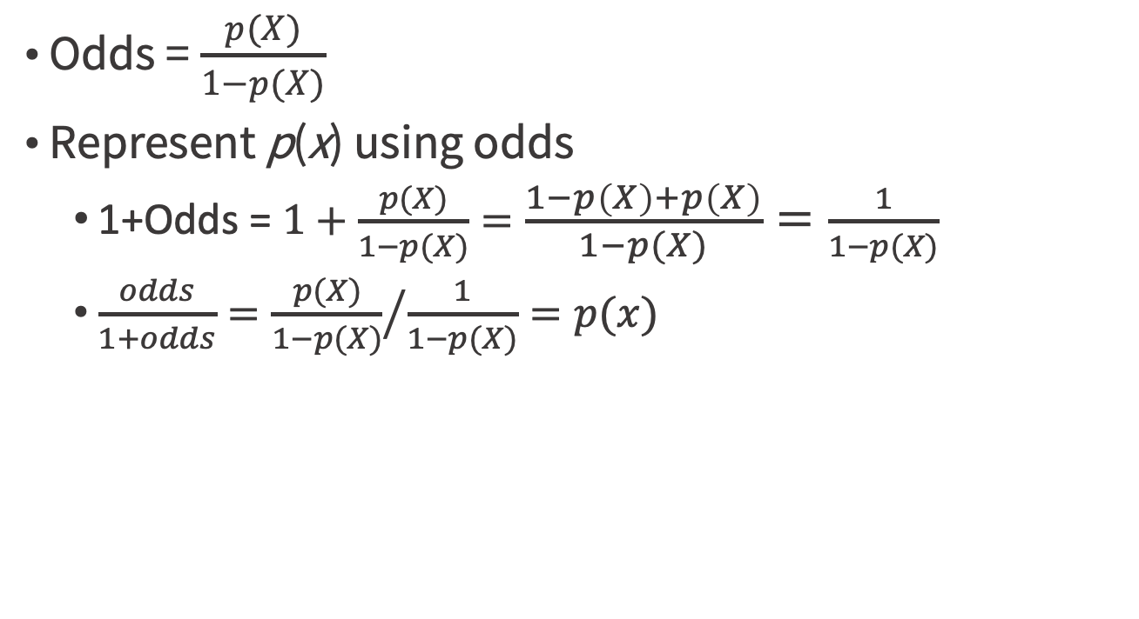
p(x) & Odds
Odds = $\frac{p(X)}{1−p(X)}$
Represent p(x) using odds
1+Odds = $1+\frac{p(X)}{1−p(X)}=\frac{1−p\left(X\right)+p\left(X\right)}{1−p(X)}=\frac{1}{1−p(X)}$
$\frac{odds}{1+odds}={\frac{p(X)}{1−p(X)}}/{\frac{1}{1−p(X)}}=p(x)$
An Introduction to Statistical Learning with Applications in R by Gareth James, Daniela Witten, Trevor Hastie, Robert Tibshirani

Slide 17
Log transformation
Let logp(x) be a linear function of x
so that changing an input variable multiplies the probability by a fixed amount
logarithms are unbounded in only one direction, and linear functions are not.
Credit by http://www.stat.cmu.edu/~cshalizi/uADA/12/lectures/ch12.pdf

Slide 18
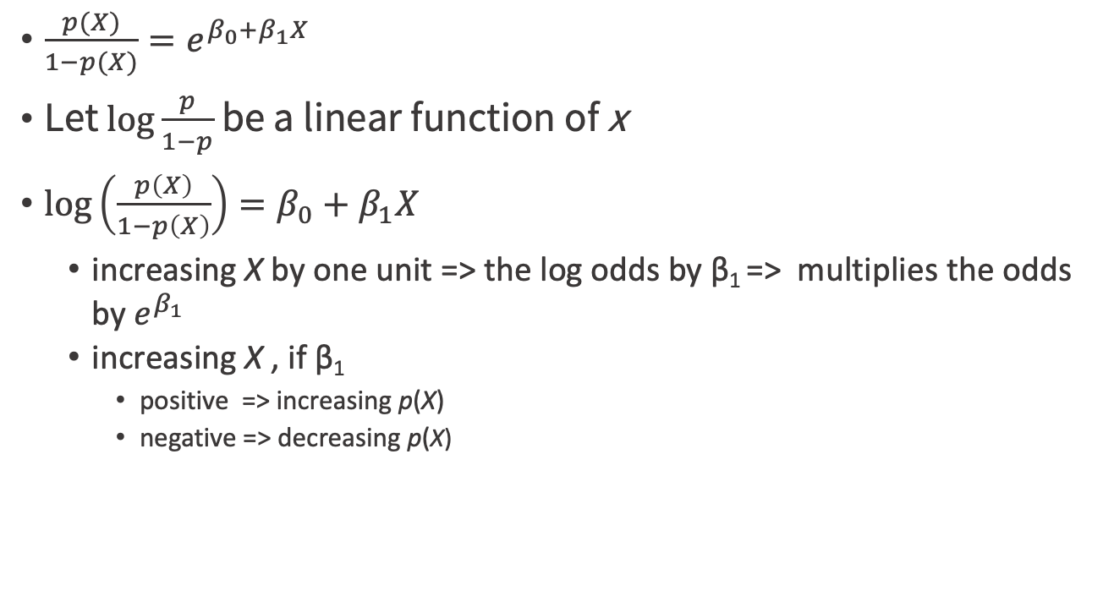
Logit / log-odds / logistic transformation
$\frac{p(X)}{1−p(X)}=e^{β_{0}+β_{1}X}$
Let $\log{\frac{p}{1−p}}$ be a linear function of x
$\log\left(\frac{p\left(X\right)}{1−p\left(X\right)}\right)=β_{0}+β_{1}X$
increasing X by one unit => the log odds by β₁ => multiplies the odds by $e^{β_{1}}$
increasing X , if β₁
positive => increasing p(X)
negative => decreasing p(X)
An Introduction to Statistical Learning with Applications in R by Gareth James, Daniela Witten, Trevor Hastie, Robert Tibshirani

Slide 19

$$\log\left(\frac{p\left(X\right)}{1−p\left(X\right)}\right)=β_{0}+β_{1}X$$
not a straight-line relationship between p(X) and X
the rate of change in p(X) per unit change in X depends on the current value of X
changing p by the same amount : a bigger change in x when p is already large (or small) > when p is close to 1/2
Linear models can’t do this
Figure4.2, An Introduction to Statistical Learning with Applications in R by Gareth James, Daniela Witten, Trevor Hastie, Robert Tibshirani

Slide 20
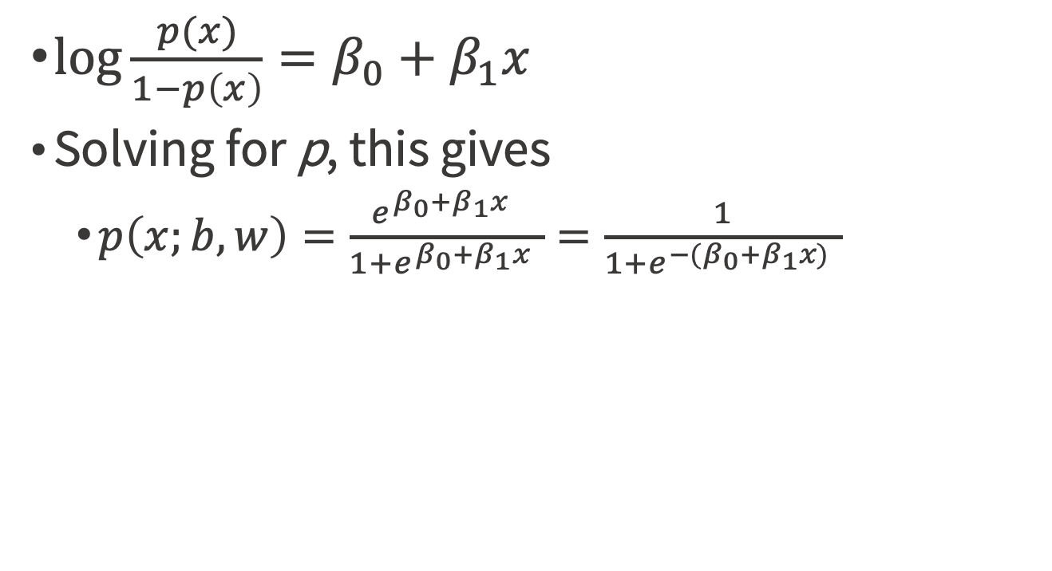
Logistic (or logit) transformation
$\log{\frac{p(x)}{1−p\left(x\right)}=β_{0}}+β_{1}x$
Solving for p, this gives
$p\left(x;b,w\right)=\frac{{e^{β_{0}+β_{1}x}}^{ }}{1+{e^{β_{0}+β_{1}x}}^{ }}=\frac{1}{1+{e^{{−(β}_{0}+β_{1}x)}}^{ }}$
Credit by http://www.stat.cmu.edu/~cshalizi/uADA/12/lectures/ch12.pdf

Slide 21
Logistic regression
P[y[i] in class]~f(x[i,]) =s(a+b[1]x[i,1]+...+b[n] x[i,n])
s(z) = 1/(1+exp(z))
sigmoid function , maps real numbers to the interval (0,1)
inverse of the sigmoid is the logit
assumes that logit(y) is linear in the values of x => as a linear regression that finds the log-odds of the probability that you’re interested in.
find the b[1], ..., b[n] such that f(x[i,]) is the best possible estimate of y[i]

Slide 22
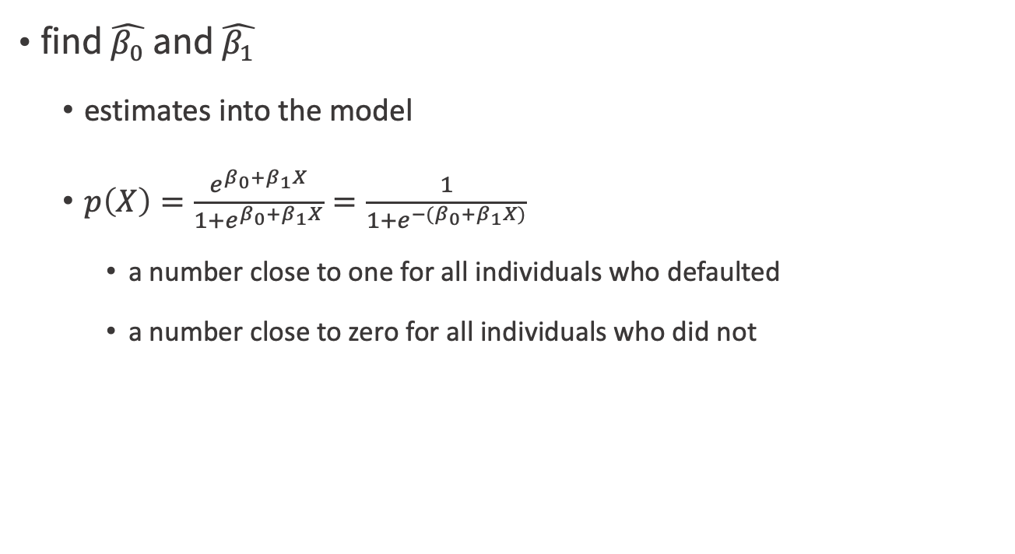
Estimating the Regression Coefficients
find $\hat{β_{0}}$ and $\hat{β_{1}}$
estimates into the model
$p\left(X\right)=\frac{e^{β_{0}+β_{1}X}}{1+e^{β_{0}+β_{1}X}}=\frac{1}{1+e^{{−(β}_{0}+β_{1}X)}}$
a number close to one for all individuals who defaulted
a number close to zero for all individuals who did not
An Introduction to Statistical Learning with Applications in R by Gareth James, Daniela Witten, Trevor Hastie, Robert Tibshirani

Slide 23
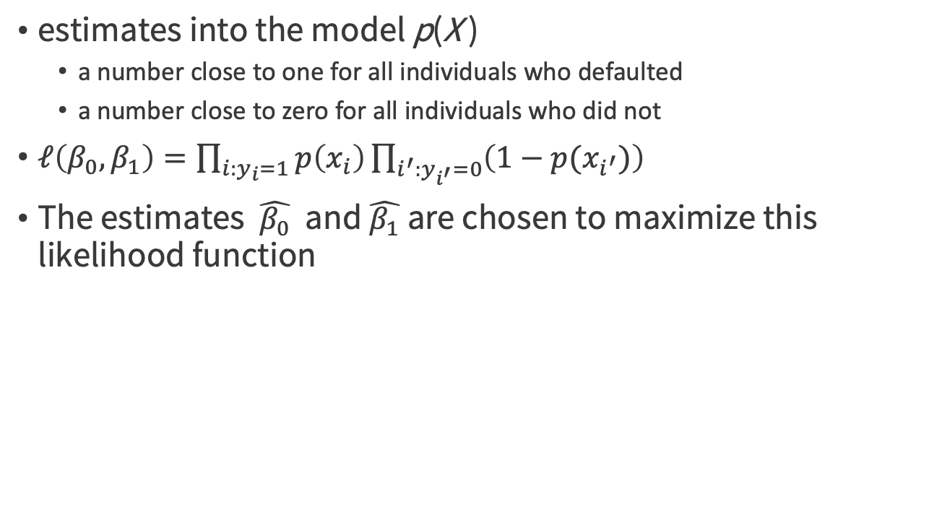
Likelihood function
estimates into the model p(X )
a number close to one for all individuals who defaulted
a number close to zero for all individuals who did not
$ℓ\left(β_{0},β_{1}\right)=\prod_{i:y_{i}=1}{p\left(x_{i}\right)}\prod_{i^{′}:y_{i^{′}}=0}{\left({1−p(x}_{i^{′}})\right)}$
The estimates $\hat{β_{0}}$ and $\hat{β_{1}}$are chosen to maximize this likelihood function
An Introduction to Statistical Learning with Applications in R by Gareth James, Daniela Witten, Trevor Hastie, Robert Tibshirani

Slide 24
The Simpler Derivation of Logistic Regression
https://win-vector.com/2011/09/14/the-simpler-derivation-of-logistic-regression/
An Introduction to Statistical Learning with Applications in R by Gareth James, Daniela Witten, Trevor Hastie, Robert Tibshirani

Slide 25
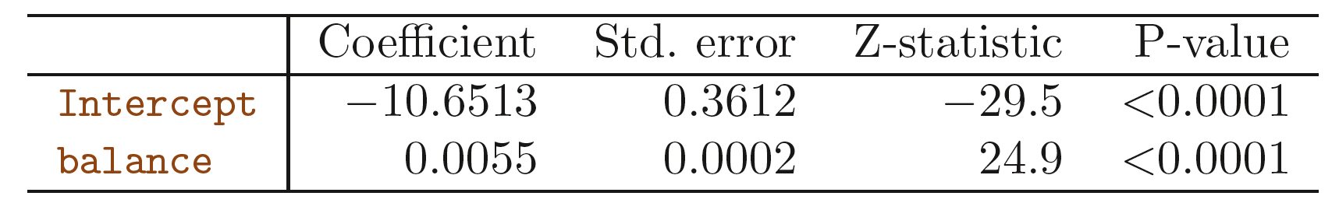
An example
a one-unit increase in balance is associated with an increase in the log odds of default by 0.0055 unit
An Introduction to Statistical Learning with Applications in R by Gareth James, Daniela Witten, Trevor Hastie, Robert Tibshirani

Slide 26
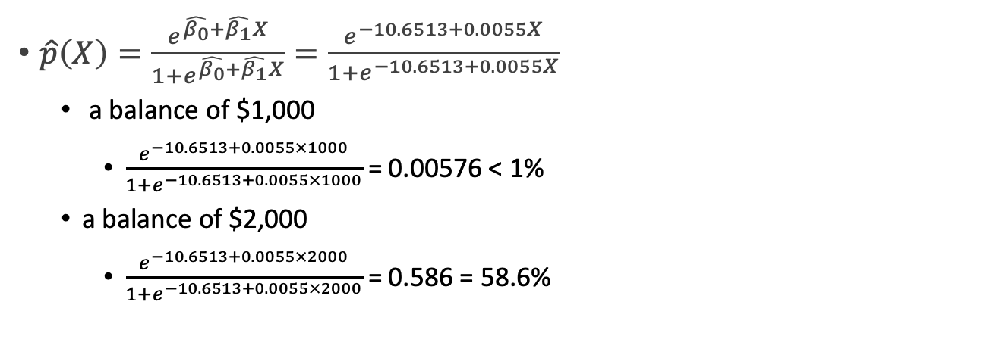
Making Predictions
$\hat{p}\left(X\right)=\frac{e^{\hat{β_{0}}+\hat{β_{1}}X}}{1+e^{\hat{β_{0}}+\hat{β_{1}}X}}=\frac{e^{−10.6513+0.0055X}}{1+e^{−10.6513+0.0055X}}$
a balance of $1,000
$\frac{e^{−10.6513+0.0055×1000}}{1+e^{−10.6513+0.0055×1000}}$ = 0.00576 < 1%
a balance of $2,000
$\frac{e^{−10.6513+0.0055×2000}}{1+e^{−10.6513+0.0055×2000}}$ = 0.586 = 58.6%
An Introduction to Statistical Learning with Applications in R by Gareth James, Daniela Witten, Trevor Hastie, Robert Tibshirani

Slide 27
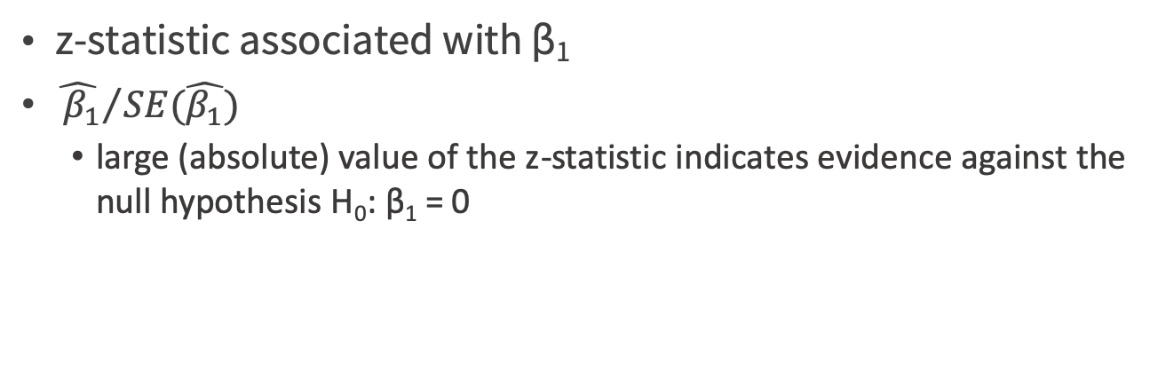
z-statistic
z-statistic associated with β₁
${ \hat{{ β}_{1}}}/{SE(\hat{β_{1}})}$
large (absolute) value of the z-statistic indicates evidence against the null hypothesis H₀: β₁ = 0
An Introduction to Statistical Learning with Applications in R by Gareth James, Daniela Witten, Trevor Hastie, Robert Tibshirani

Slide 28
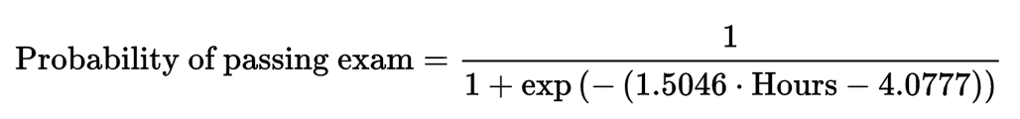
Graph of a logistic regression curve showing probability of passing an exam versus hours studying
Credit by https://en.wikipedia.org/wiki/Logistic_regression

Slide 29
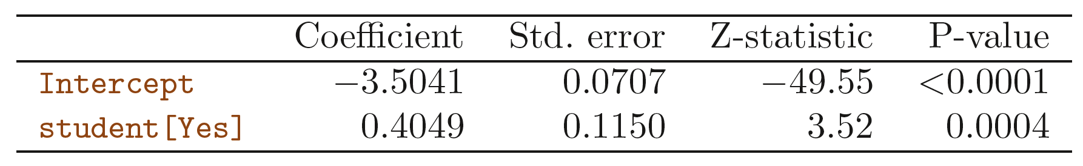
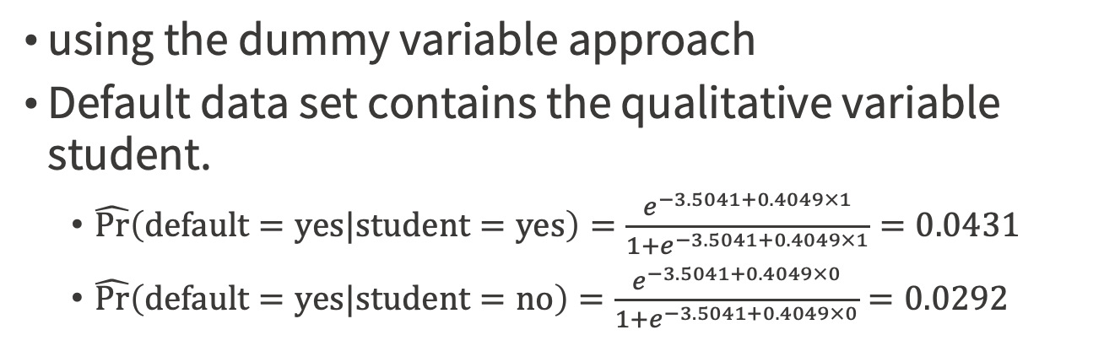
Qualitative predictors with the logistic regression model
using the dummy variable approach
Default data set contains the qualitative variable student.
$\hat{\text{Pr}}\left(\text{default}=\text{yes}|\text{student}=\text{yes}\right)=\frac{e^{−3.5041+0.4049×1}}{1+e^{−3.5041+0.4049×1}}=0.0431$
$\hat{\text{Pr}}\left(\text{default}=\text{yes}|\text{student}=\text{no}\right)=\frac{e^{−3.5041+0.4049×0}}{1+e^{−3.5041+0.4049×0}}=0.0292$
An Introduction to Statistical Learning with Applications in R by Gareth James, Daniela Witten, Trevor Hastie, Robert Tibshirani

Slide 30
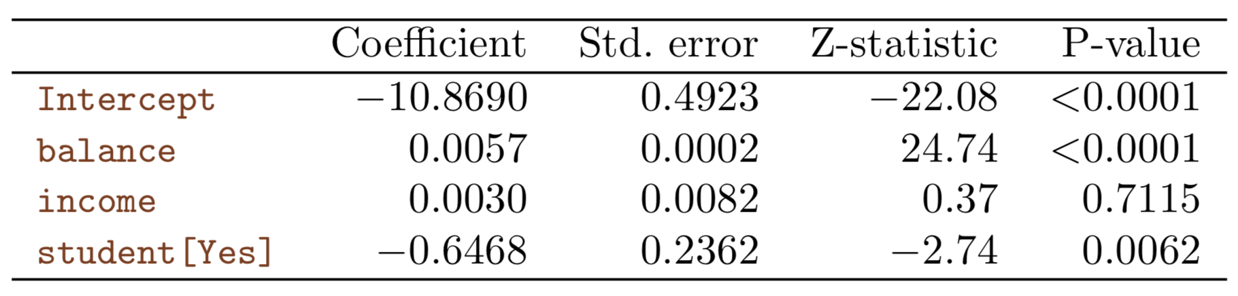
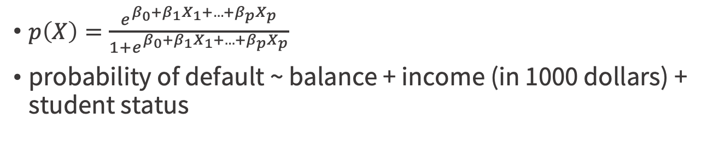
Multiple Logistic Regression
$p\left(X\right)=\frac{e^{β_{0}+β_{1}X_{1}+{…+β}_{p}X_{p}}}{1+e^{β_{0}+β_{1}X_{1}+{…+β}_{p}X_{p}}}$
probability of default ~ balance + income (in 1000 dollars) + student status
An Introduction to Statistical Learning with Applications in R by Gareth James, Daniela Witten, Trevor Hastie, Robert Tibshirani

Slide 31
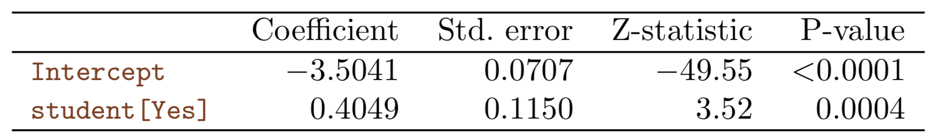
Student status increase or decrease?
An Introduction to Statistical Learning with Applications in R by Gareth James, Daniela Witten, Trevor Hastie, Robert Tibshirani

Slide 32
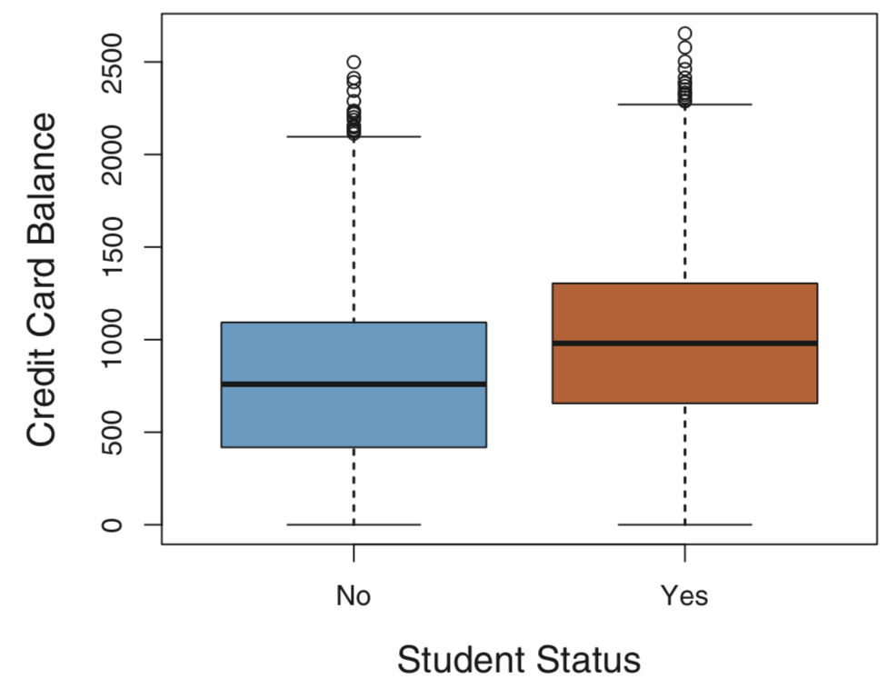
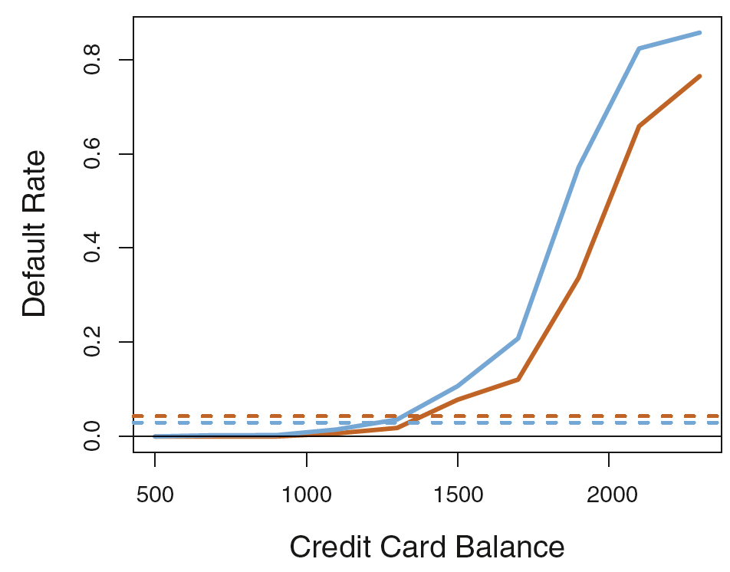
Confounding
Figure4.3, p137, An Introduction to Statistical Learning, with applications in R" (Springer, 2013) with permission from the authors: G. James, D. Witten, T. Hastie and R. Tibshirani

Slide 33
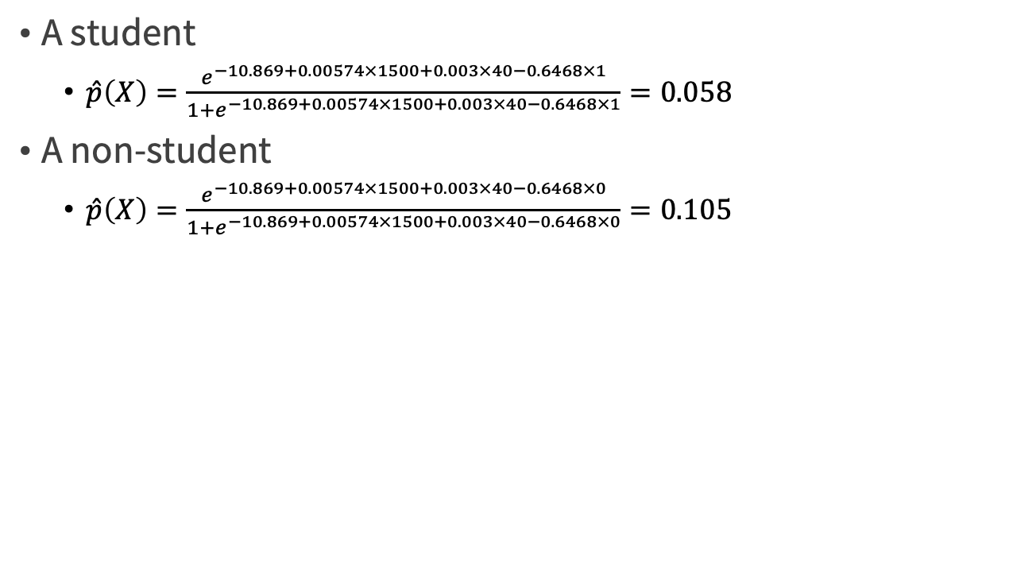
A credit card balance of $1,500 and an income of $40,000
A student
$\hat{p}\left(X\right)=\frac{e^{−10.869+0.00574×1500+0.003×40−0.6468×1}}{1+e^{−10.869+0.00574×1500+0.003×40−0.6468×1}}=0.058$
A non-student
$\hat{p}\left(X\right)=\frac{e^{−10.869+0.00574×1500+0.003×40−0.6468×0}}{1+e^{−10.869+0.00574×1500+0.003×40−0.6468×0}}=0.105$
An Introduction to Statistical Learning with Applications in R by Gareth James, Daniela Witten, Trevor Hastie, Robert Tibshirani

Slide 34
Practice time

Slide 35
Prepare data
The goal is to design a plan that provisions neonatal emergency equipment to delivery rooms.
CDC/cdc.R
load("NatalRiskData.rData")
train <- sdata[sdata$ORIGRANDGROUP<=5,]
test <- sdata[sdata$ORIGRANDGROUP>5,]
Practical Data Science with R by Nina Zumel, John Mount

Slide 36
Variables in natality dataset
Variable | Type | Description
atRisk | Logical | TRUE if 5-minute Apgar score < 7; FALSE otherwise
PWGT | Numeric | Mother’s prepregnancy weight
UPREVIS | Numeric | Number of prenatal medical visits
UPREVIS | Logical | TRUE if smoker; FALSE otherwise
GESTREC3 | Categorical | Two categories: <37 weeks (premature) and >=37 weeks
DPLURAL | Categorical | Birth plurality, three categories: single/twin/triplet+
ULD_MECO | Logical | TRUE if moderate/heavy fecal staining of amniotic fluid
ULD_PRECIP | Logical | TRUE for unusually short labor (< three hours)
ULD_BREECH | Logical | TRUE for breech (pelvis first) birth position
URF_DIAB | Logical | TRUE if mother is diabetic
URF_CHYPER | Logical | TRUE if mother has chronic hypertension
URF_PHYPER | Logical | TRUE if mother has pregnancy-related hypertension
URF_ECLAM | Logical | TRUE if mother experienced eclampsia: pregnancyrelated seizures
Practical Data Science with R by Nina Zumel, John Mount

Slide 37
Building a logistic regression model
complications <- c("ULD_MECO","ULD_PRECIP","ULD_BREECH")
riskfactors <- c("URF_DIAB", "URF_CHYPER", "URF_PHYPER", "URF_ECLAM")
y <- "atRisk"
x <- c("PWGT", "UPREVIS", "CIG_REC", "GESTREC3", "DPLURAL", complications, riskfactors)
fmla <- paste(y, paste(x, collapse="+"), sep="~")
Practical Data Science with R by Nina Zumel, John Mount

Slide 38
Fitting the logistic regression model
print(fmla)
model <- glm(fmla, data=train, family=binomial(link="logit"))
The family function specifies the assumed distribution of the dependent variable y
The link function links the output to a linear model—pass y through the link function, and then model the resulting value as a linear function of the x values.
Practical Data Science with R by Nina Zumel, John Mount

Slide 39
Making predictions
train$pred <- predict(model,newdata=train, type="response")
test$pred <- predict(model,newdata=test, type="response")
default predict() will return the output of the link function, logit(y)
type="response” : tells the predict() function to return the predicted probabilities y
Practical Data Science with R by Nina Zumel, John Mount

Slide 40
Making predictions
One strength of logistic regression is that it preserves the marginal probabilities of the training data.
sum up the predicted probability scores for the entire training set = # of positive outcomes in the training set
Practical Data Science with R by Nina Zumel, John Mount

Slide 41
Characterizing prediction quality
library(ggplot2)
ggplot(train, aes(x=pred, color=atRisk, linetype=atRisk)) + geom_density()
Practical Data Science with R by Nina Zumel, John Mount

Slide 42
Characterizing prediction quality
Surprise or not-surprise?
Not surprising => since the positive instances (the ones with the baby at risk) are rare (about 1.8% of all births in the dataset)
How to pick a threshold to define positive & negative?
precision vs recall
Practical Data Science with R by Nina Zumel, John Mount

Slide 43
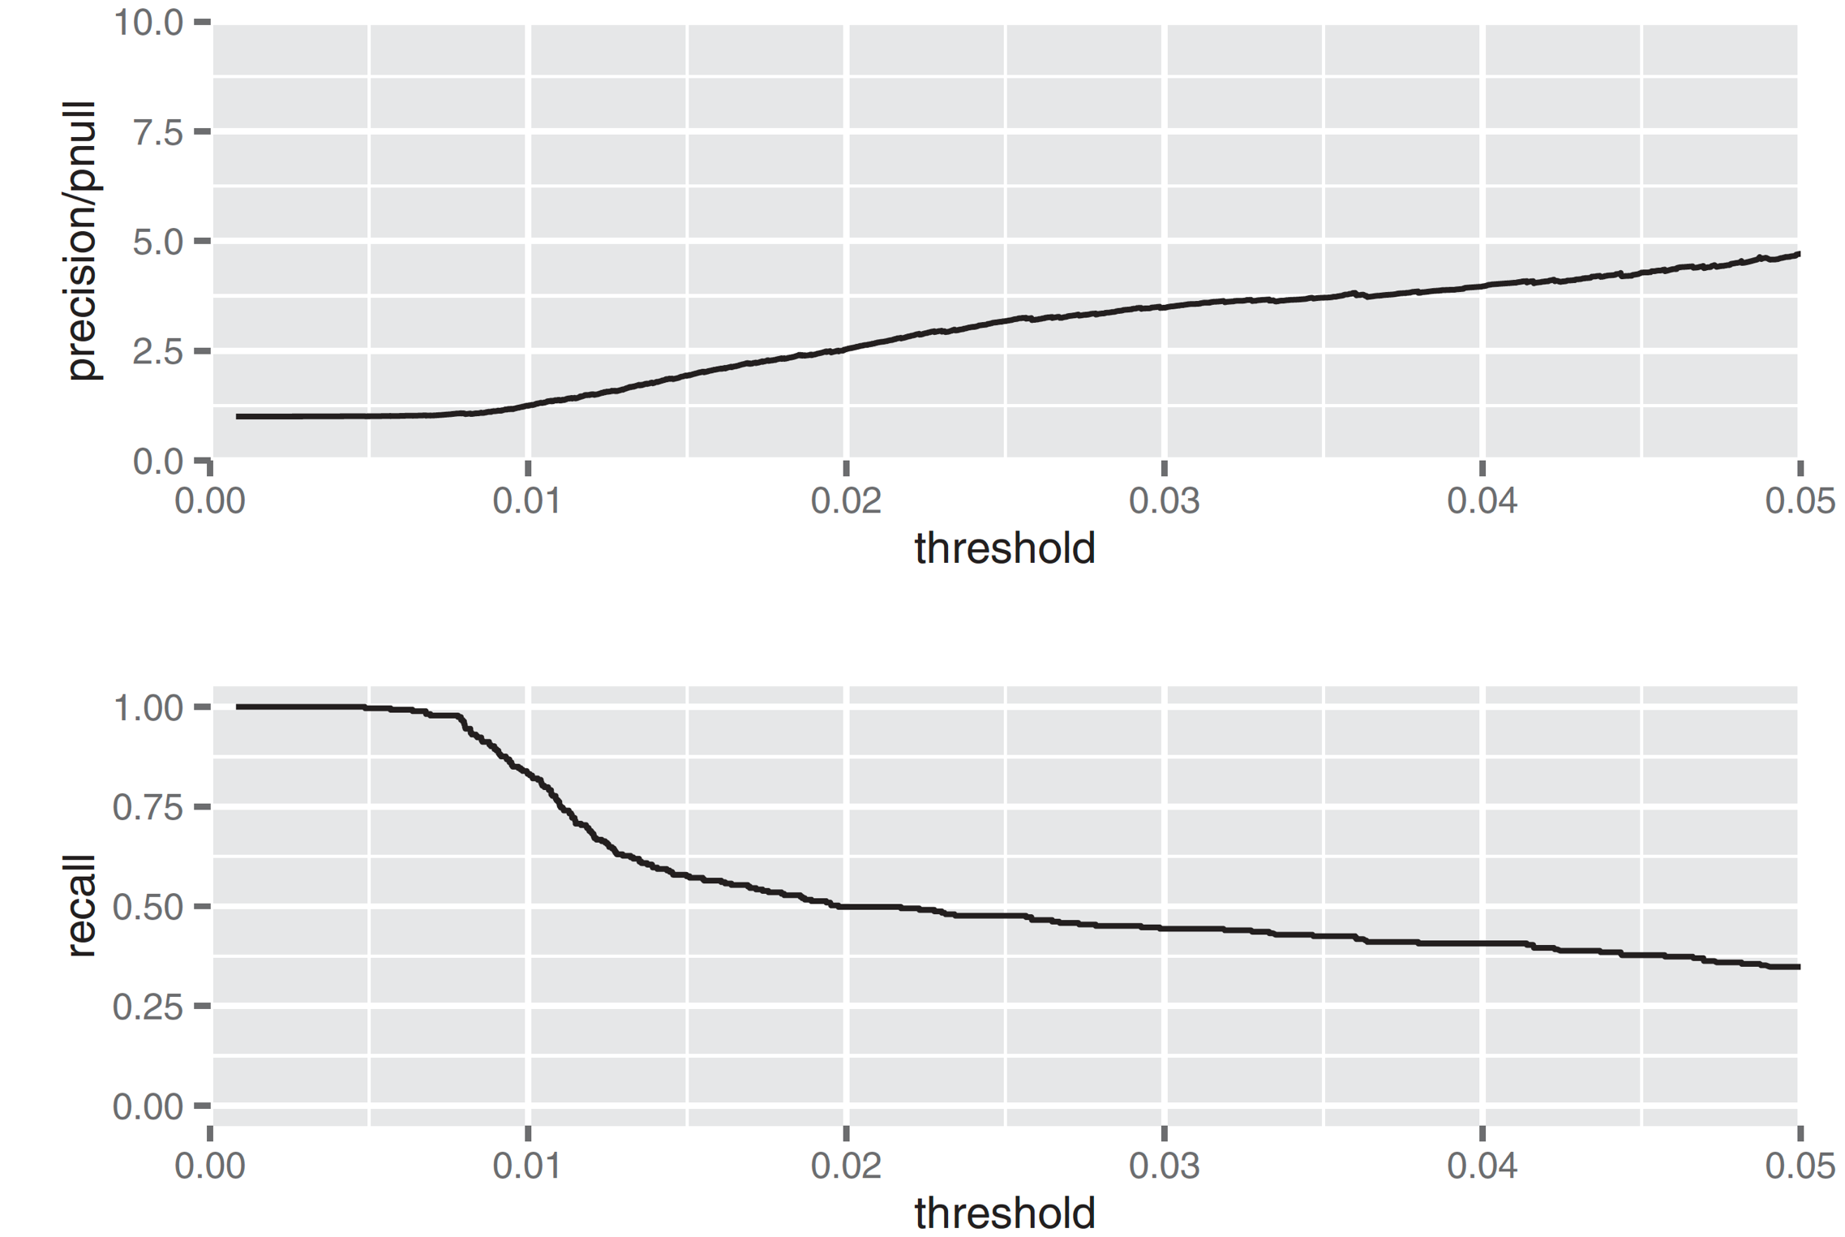
How to pick a threshold?
enrichment rate
the ratio of the classifier precision to the average rate of positives
Figure7.10, Practical Data Science with R by Nina Zumel, John Mount

Slide 44
How to pick a threshold?
library(ROCR)
library(grid)
predObj <- prediction(train$pred, train$atRisk)
precObj <- performance(predObj, measure="prec")
recObj <- performance(predObj, measure="rec")
precision <- (precObj@y.values)[[1]]
prec.x <- (precObj@x.values)[[1]]
recall <- (recObj@y.values)[[1]]
rocFrame <- data.frame(threshold=prec.x, precision=precision, recall=recall)
Practical Data Science with R by Nina Zumel, John Mount

Slide 45
How to pick a threshold?
nplot <- function(plist) {
n <- length(plist)
grid.newpage()
pushViewport(viewport(layout=grid.layout(n,1)))
vplayout=function(x,y) {viewport(layout.pos.row=x, layout.pos.col=y)}
for(i in 1:n) {
print(plist[[i]], vp=vplayout(i,1))
}
}
pnull <- mean(as.numeric(train$atRisk))
Practical Data Science with R by Nina Zumel, John Mount

Slide 46
How to pick a threshold?
p1 <- ggplot(rocFrame, aes(x=threshold)) + geom_line(aes(y=precision/pnull)) + coord_cartesian(xlim = c(0,0.05), ylim=c(0,10) )
p2 <- ggplot(rocFrame, aes(x=threshold)) + geom_line(aes(y=recall)) + coord_cartesian(xlim = c(0,0.05) )
nplot(list(p1, p2))
Practical Data Science with R by Nina Zumel, John Mount

Slide 47
Evaluating our chosen model on test data
By what?
confusion matrix
ctab.test <- table(pred=test$pred>0.02, atRisk=test$atRisk)
precision <- ctab.test[2,2]/sum(ctab.test[2,])
recall <- ctab.test[2,2]/sum(ctab.test[,2])
enrich <- precision/mean(as.numeric(test$atRisk))
Practical Data Science with R by Nina Zumel, John Mount

Slide 48
Characterizing coefficients
The summary coefficients table
A coefficient
Its estimated value
The error around that estimate
The signed distance of the estimated coefficient value from 0
using the standard error as the unit of distance
The probability of seeing a coefficient value at least as large as we observed, under the null hypothesis that the coefficient value is really 0
p-value or significance
whether we should trust the estimated coefficient value: <= 0.05 are reliable
Practical Data Science with R by Nina Zumel, John Mount

Slide 49
Finding relations and extracting advice from logistic models
The coefficients of a logistic regression model encode the relationships between the input variables and the output.
correlated to the odds
coefficients(model)
Practical Data Science with R by Nina Zumel, John Mount

Slide 50
Finding relations and extracting advice from logistic models
coefficients(model)
If the original variable has n levels => will be n -1 indicator variables, why?
DPLURAL
single births
Twins : DPLURALtwin
triplets or higher : DPLURALtriplet or higher.
LOGISTIC REGRESSION ALSO DISLIKES A VERY LARGE VARIABLE COUNT
Practical Data Science with R by Nina Zumel, John Mount

Slide 51
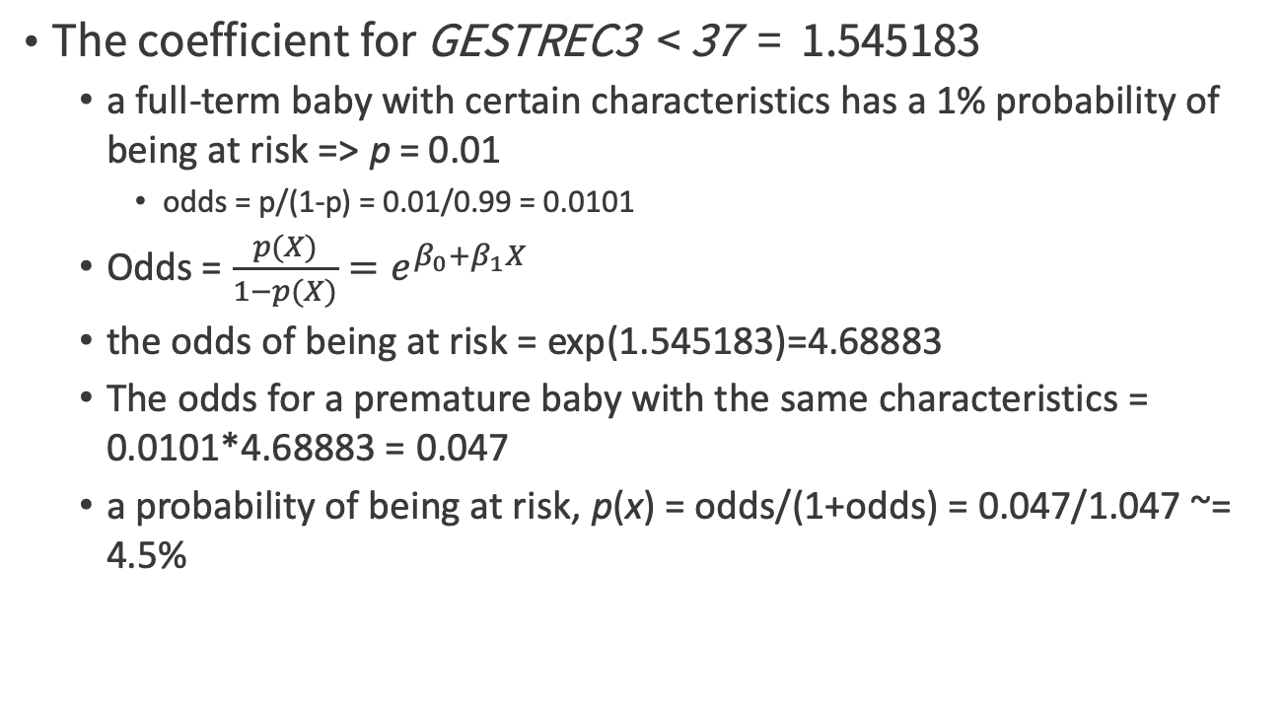
How to interpreting the coefficients?
The coefficient for GESTREC3 < 37 = 1.545183
a full-term baby with certain characteristics has a 1% probability of being at risk => p = 0.01
odds = p/(1-p) = 0.01/0.99 = 0.0101
Odds = $\frac{p(X)}{1−p(X)}=e^{β_{0}+β_{1}X}$
the odds of being at risk = exp(1.545183)=4.68883
The odds for a premature baby with the same characteristics = 0.0101*4.68883 = 0.047
a probability of being at risk, p(x) = odds/(1+odds) = 0.047/1.047 ~= 4.5%
Practical Data Science with R by Nina Zumel, John Mount

Slide 52
How to interpreting the coefficients?
The coefficient for UPREVIS (number of prenatal medical visits) = -0.06
the odds of being at risk = exp(-0.06)= 0.94
Suppose the mother of our premature baby had made no prenatal visits
a baby in the same situation whose mother had made three prenatal visits
odds of being at risk = 0.047 * 0.94 * 0.94 * 0.94 = 0.039
a probability of being at risk = 0.039/1.039 = 3.75%.
Practical Data Science with R by Nina Zumel, John Mount

Slide 53
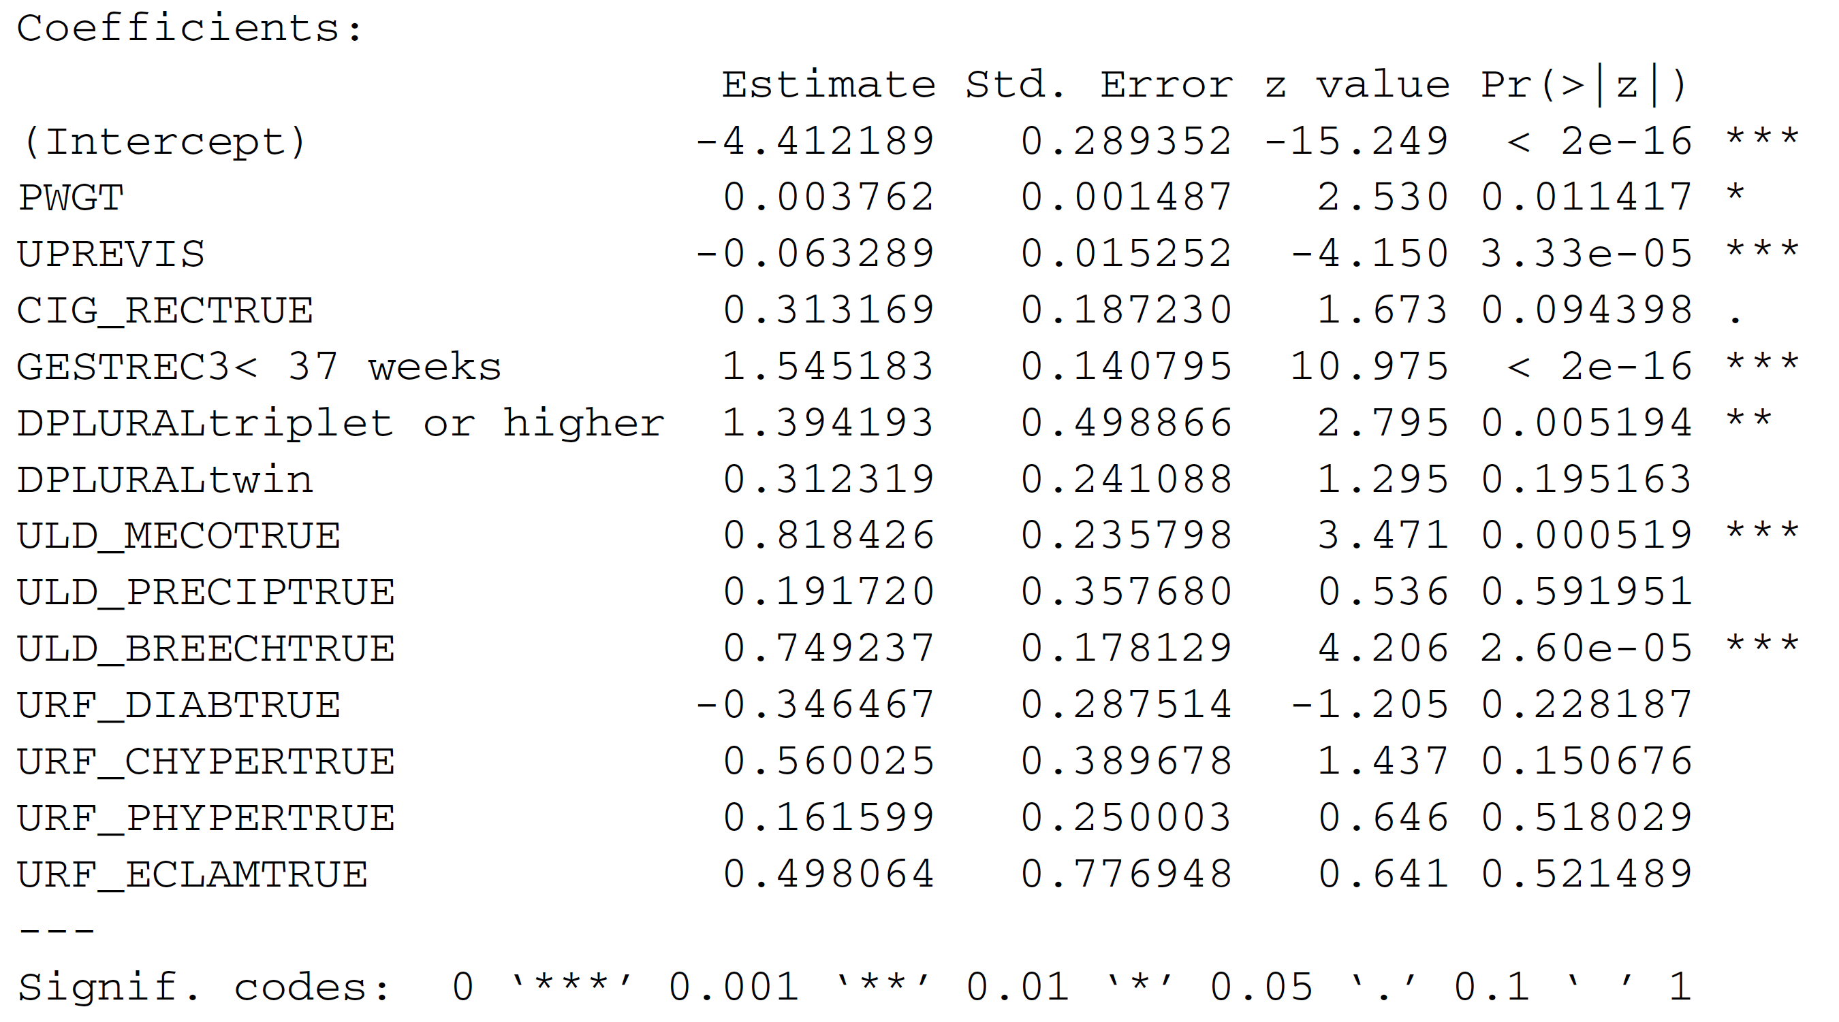
Characterizing coefficients
The summary coefficients table
Practical Data Science with R by Nina Zumel, John Mount

Slide 54
Lack of significance could mean collinear inputs
Add babies’ birth weight into model : DBWT
the coefficient for DBWT will be non-negligible and significant
DPLURALtriplet or higher will appear insignificant
the coefficient for GESTREC3< 37 weeks has a much smaller magnitude
Why?
Practical Data Science with R by Nina Zumel, John Mount

Slide 55
Lack of significance could mean collinear inputs
Low birth weight is correlated to both prematurity and multiple birth
Why not include CBWT into our model?
Other signs of possibly collinear inputs
coefficients with the wrong sign
unusually large coefficient magnitudes
Practical Data Science with R by Nina Zumel, John Mount

Slide 56
Reading the model summary and characterizing coefficients
summary(model)
THE ORIGINAL MODEL CALL
Call:
glm(formula = fmla, family = binomial(link = "logit"), data = train)
Practical Data Science with R by Nina Zumel, John Mount

Slide 57
Reading the model summary and characterizing coefficients
summary(model)
THE DEVIANCE RESIDUALS SUMMARY
Deviance Residuals:
Min 1Q Median 3Q Max
-0.9732 -0.1818 -0.1511 -0.1358 3.2641
linear regression = vector of differences between the true outcome values and the predicted output values (the errors).
logistic regression = the log likelihoods of having observed the true outcome, given the predicted probability of that outcome => that positive instances y should have high probability p(y) of occurring under the model
Practical Data Science with R by Nina Zumel, John Mount

Slide 58
Overall model quality summaries
Deviance = a measure of how well the model fits the data
2 x the negative log likelihood of the dataset | given the model
Objective function
linear regression models = minimizing the sum of the squared residuals
logistic regression models = minimizing the sum of the squared residual deviances => maximizing the log likelihood of the data, given the model
Practical Data Science with R by Nina Zumel, John Mount

Slide 59
Overall model quality summaries
null deviance : similar to the variance of the data around the average rate of positive examples
residual deviance : similar to the variance of the data around the model
Practical Data Science with R by Nina Zumel, John Mount

Slide 60
null deviance VS residual deviance
check whether the model’s probability predictions are better than just guessing the average rate of positives?
=> is the reduction in deviance from the model meaningful, or just something that was observed by chance?
Practical Data Science with R by Nina Zumel, John Mount

Slide 61
Computing deviance
loglikelihood <- function(y, py) {
sum(y * log(py) + (1-y)*log(1 - py))
}
pnull <- mean(as.numeric(train$atRisk))
null.dev <- -2*loglikelihood(as.numeric(train$atRisk), pnull)
null.dev
model$null.deviance
pred <- predict(model, newdata=train, type="response")
resid.dev <- -2*loglikelihood(as.numeric(train$atRisk), pred)
resid.dev
model$deviance
Practical Data Science with R by Nina Zumel, John Mount

Slide 62
Akaike information criterion (AIC)
the log likelihood adjusted for the # of coefficients ~ the R-squared of a linear regression is generally higher when the number of variables is high
aic <- 2*(length(model$coefficients) - loglikelihood(as.numeric(train$atRisk), pred))
decide which and how many input variables to use in the model
train many different models with different sets of variables on the same training set => the model with the lowest AIC to be the best fit
Practical Data Science with R by Nina Zumel, John Mount

Slide 63
Overall model quality summaries
Null deviance: 2698.7 on 14211 degrees of freedom
Residual deviance: 2463.0 on 14198 degrees of freedom
AIC: 2491
Practical Data Science with R by Nina Zumel, John Mount

Slide 64
null deviance VS residual deviance
the degrees of freedom
the null model : df.null = dim(train)[[1]] - 1
the actual model : df.model = dim(train)[[1]] - length(model$coefficients)
Practical Data Science with R by Nina Zumel, John Mount

Slide 65
null deviance VS residual deviance
Calculating the significance of the observed fit using chi-squared test
delDev <- null.dev - resid.dev
deldf <- df.null - df.model
p <- pchisq(delDev, deldf, lower.tail=F)
p-value?
it’s extremely unlikely that we could’ve seen this much reduction in deviance by chance.
Practical Data Science with R by Nina Zumel, John Mount

Slide 66
The pseudo R-squared
1 - (dev.model/dev.null)
how much of the deviance is explained by the model => ideal, be close to 1
pr2<- 1-(resid.dev/null.dev)
pr2.test<- 1-(resid.dev.test/null.dev.test)
Highly predictive model or not?
The model only explains about 7.7–8.7% of the deviance => not a highly predictive model
we haven’t yet identified all the factors that actually predict at-risk births.
Practical Data Science with R by Nina Zumel, John Mount

Slide 67
P-value & the pseudo R-squared
The good p-value but the poor pseudo R-squared
The good p-value => the model is legitimate, it gives us more information than the average rate of at-risk births does alone.
The poor pseudo R-squared => the model isn’t giving us enough information to predict at-risk births with high reliability.
Practical Data Science with R by Nina Zumel, John Mount

Slide 68
P-value & The pseudo R-squared
A bad p-vlaue but a good pseudo R-squared (on the training data)
an indication of overfit
it’s a good idea to check both
check the pseudo R-squared of the model on both training and test data.
Practical Data Science with R by Nina Zumel, John Mount

Slide 69
Fisher scoring iterations
An iterative optimization method that glm() uses to find the best coefficients for the logistic regression model
You should expect it to converge in about 6~8 iterations.
If there are more iterations than that, then the algorithm may not have converged, and the model may not be valid.
Practical Data Science with R by Nina Zumel, John Mount

Slide 70
Separation and quasi-separation
The probable reason for nonconvergence is separation or quasi-separation
one of the model variables or some combination of the model variables predicts the outcome perfectly
Warning message:
glm.fit: fitted probabilities numerically 0 or 1 occurred
Other warning messages => suspect model
An unusually high number of Fisher iterations
Very large coefficients, usually with extremely large standard errors
Residual deviances larger than the null deviances
Practical Data Science with R by Nina Zumel, John Mount

Slide 71
Separation and quasi-separation
To try to fix the problem, remove any variables with unusually large coefficients
The overall model would then be a hybrid
the decision tree to predict the too-good data
a logistic regression model for the rest
Practical Data Science with R by Nina Zumel, John Mount

Slide 72
Multinomial logistic regression
polytomous LR
multiclass LR
softmax regression
multinomial logit (mlogit)
the maximum entropy (MaxEnt) classifier
the conditional maximum entropy model
categorical logistic regression

Slide 73
Multinomial logistic regression
a classification method that generalizes logistic regression to multiclass problems, with more than two possible discrete outcomes
Which major will a college student choose, given their grades, stated likes and dislikes, etc.?
Which blood type does a person have, given the results of various diagnostic tests?
https://en.wikipedia.org/wiki/Multinomial_logistic_regression

Slide 74
The reference category
One category of the response variable must be chosen as the reference category.
Separate odds ratios are determined for all explanatory variables for each category of the response variable, except for the reference category.
The odds ratios then represent the change in odds of the outcome being a particular category versus the reference category, for differing factor levels of the corresponding explanatory variable.
Credit by https://select-statistics.co.uk/blog/analysing-categorical-data-using-logistic-regression-models/

Slide 75
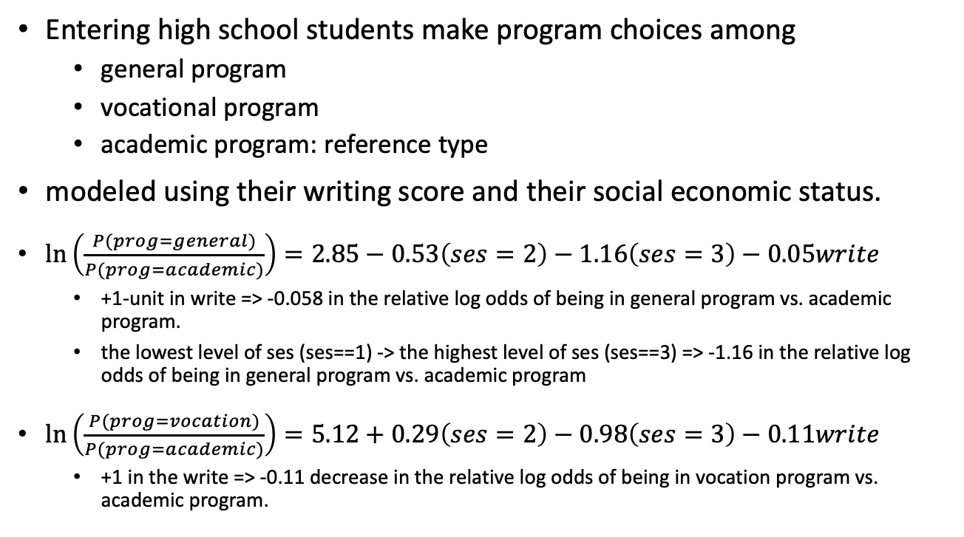
An example
Entering high school students make program choices among
general program
vocational program
academic program: reference type
modeled using their writing score and their social economic status.
$\ln\left(\frac{P(prog=general)}{P(prog=academic)}\right)=2.85−0.53\left(ses=2\right)−1.16\left(ses=3\right)−0.05write$
+1-unit in write => -0.058 in the relative log odds of being in general program vs. academic program.
the lowest level of ses (ses==1) -> the highest level of ses (ses==3) => -1.16 in the relative log odds of being in general program vs. academic program
$\ln\left(\frac{P(prog=vocation)}{P(prog=academic)}\right)=5.12+0.29\left(ses=2\right)−0.98\left(ses=3\right)−0.11write$
+1 in the write => -0.11 decrease in the relative log odds of being in vocation program vs. academic program.
Credit by https://stats.idre.ucla.edu/stata/dae/multinomiallogistic-regression/

Slide 76
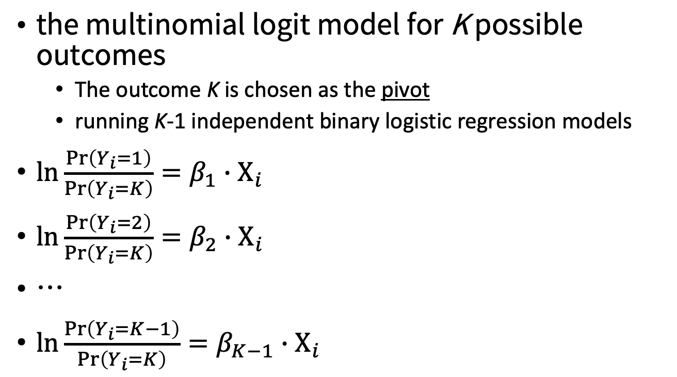
a set of independent binary regressions
the multinomial logit model for K possible outcomes
The outcome K is chosen as the pivot
running K-1 independent binary logistic regression models
$\ln{\frac{Pr⁡\left(Y_{i}=1\right)}{Pr\left(Y_{i}=K\right)}}=β_{1}∙Χ_{i}$
$\ln{\frac{Pr⁡\left(Y_{i}=2\right)}{Pr\left(Y_{i}=K\right)}}=β_{2}∙Χ_{i}$
…
$\ln{\frac{Pr⁡\left(Y_{i}=K−1\right)}{Pr\left(Y_{i}=K\right)}}=β_{K−1}∙Χ_{i}$
https://en.wikipedia.org/wiki/Multinomial_logistic_regression

Slide 77
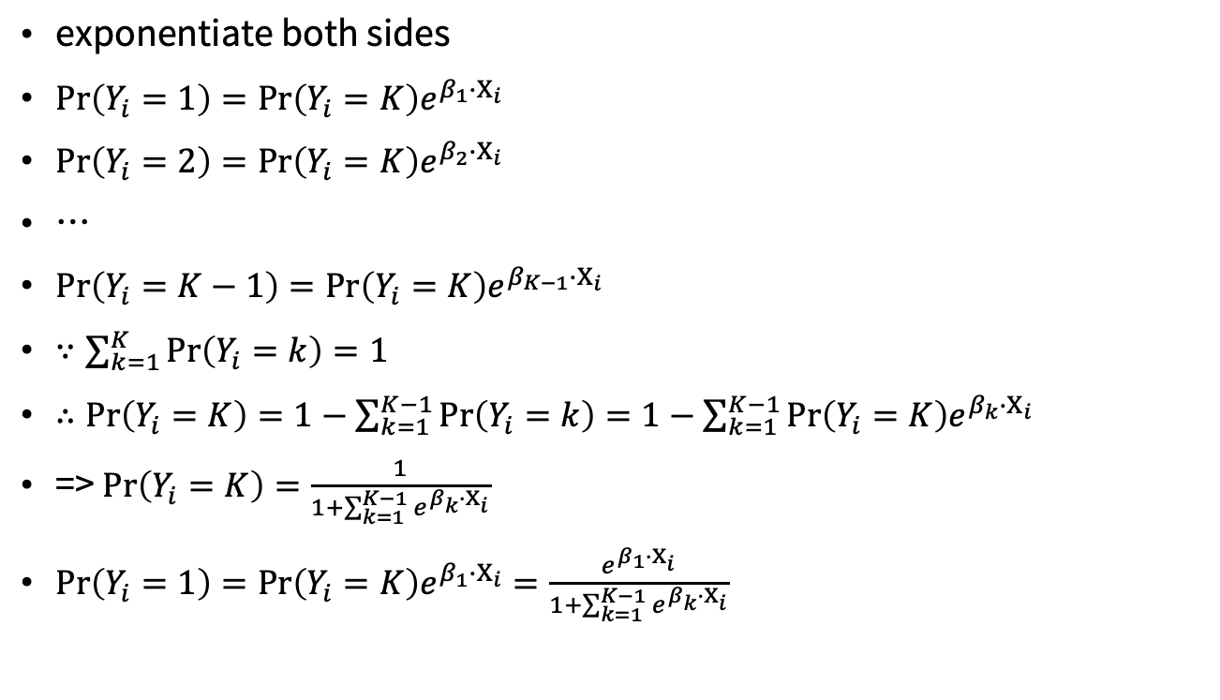
Probabilities of each output
exponentiate both sides
$Pr\left(Y_{i}=1\right)=\text{Pr}\left(Y_{i}=K\right)e^{β_{1}∙Χ_{i}}$
$Pr\left(Y_{i}=2\right)=\text{Pr}\left(Y_{i}=K\right)e^{β_{2}∙Χ_{i}}$
…
$Pr\left(Y_{i}=K−1\right)=\text{Pr}\left(Y_{i}=K\right)e^{β_{K−1}∙Χ_{i}}$
$∵\sum_{k=1}^{K}{\text{Pr}\left(Y_{i}=k\right)}=1$
$∴Pr\left(Y_{i}=K\right)=1−\sum_{k=1}^{K−1}{\text{Pr}\left(Y_{i}=k\right)}=1−\sum_{k=1}^{K−1}{\text{Pr}\left(Y_{i}=K\right)e^{β_{k}∙Χ_{i}}}$
=> $Pr\left(Y_{i}=K\right)=\frac{1}{1+\sum_{k=1}^{K−1}{e^{β_{k}∙Χ_{i}}}}$
$Pr\left(Y_{i}=1\right)=\text{Pr}\left(Y_{i}=K\right)e^{β_{1}∙Χ_{i}}=\frac{e^{β_{1}∙Χ_{i}}}{1+\sum_{k=1}^{K−1}{e^{β_{k}∙Χ_{i}}}}$
https://en.wikipedia.org/wiki/Multinomial_logistic_regression

Slide 78
multinom function in mlogit package
require(foreign)
require(nnet)
require(ggplot2)
require(reshape2)
ml <- read.dta("https://stats.idre.ucla.edu/stat/data/hsbdemo.dta")
with(ml, table(ses, prog))
with(ml, do.call(rbind, tapply(write, prog, function(x) c(M = mean(x), SD = sd(x)))))
ml$prog2 <- relevel(ml$prog, ref = "academic") test <- multinom(prog2 ~ ses + write, data = ml)
summary(test)
https://stats.idre.ucla.edu/r/dae/multinomial-logistic-regression/

Slide 79
Takeaways

Slide 80
Logistic regression takeaways
Logistic regression is the go-to statistical modeling method for binary classification. Try logistic regression first, and then more complicated methods if logistic regression doesn’t perform well.
Logistic regression will have trouble with problems with a very large number of variables, or categorical variables with a very large number of levels.
Logistic regression is well calibrated: it reproduces the marginal probabilities of the data.
Logistic regression can predict well even in the presence of correlated variables, but correlated variables lower the quality of the advice.
Practical Data Science with R by Nina Zumel, John Mount

Slide 81
Logistic regression takeaways
Overly large coefficient magnitudes, overly large standard errors on the coefficient estimates, and the wrong sign on a coefficient could be indications of correlated inputs.
Too many Fisher iterations, or overly large coefficients with very large standard errors, could be signs that an input or combination of inputs is perfectly correlated with a subset of your responses. You may have to segment the data to deal with this issue.
glm() provides good diagnostics, but rechecking your model on test data is still your most effective diagnostic.
Pseudo R-squared is a useful goodness-of-fit heuristic.
Practical Data Science with R by Nina Zumel, John Mount

Slide 82
Key takeaways
Functional models allow you to better explore how changes in inputs affect predictions.
Linear regression is a good first technique for modeling quantities.
Logistic regression is good first technique for modeling probabilities.
Models with simple forms come with very powerful summaries and diagnostics.
Practical Data Science with R by Nina Zumel, John Mount

Slide 83

Thank You Any Question?

